Slide 1

Presentation on Fosroc ranges of Product Solutions for Precast Structures
Constructive Solutions

Slide 2
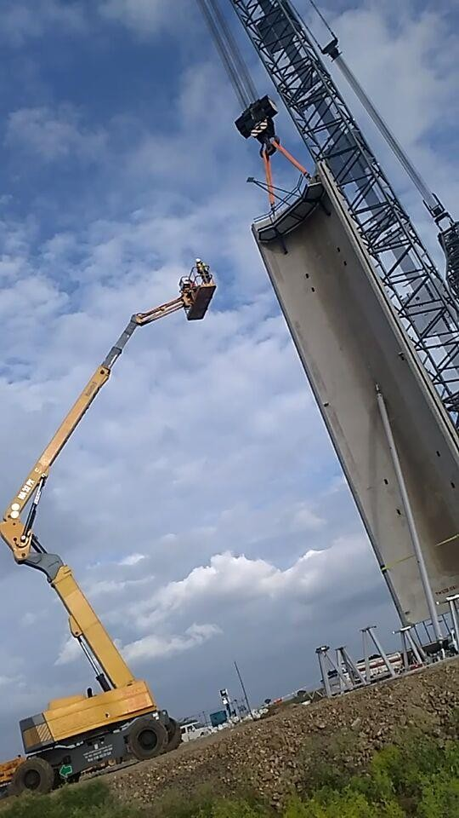
History of Precast Concrete
Precast concrete is a construction product produced by casting concrete in a reusable mould or form which is then cured in a controlled environment, transported to the construction site and lifted into place. In contrast, standard concrete is poured into site-specific forms and cured on site.
Features
Precast panelled buildings were pioneered in Liverpool, England, in 1905.
The tram stables at Walton in Liverpool followed in
1906.
However, it was adopted all over the world, particularly in Eastern Europe

Slide 3
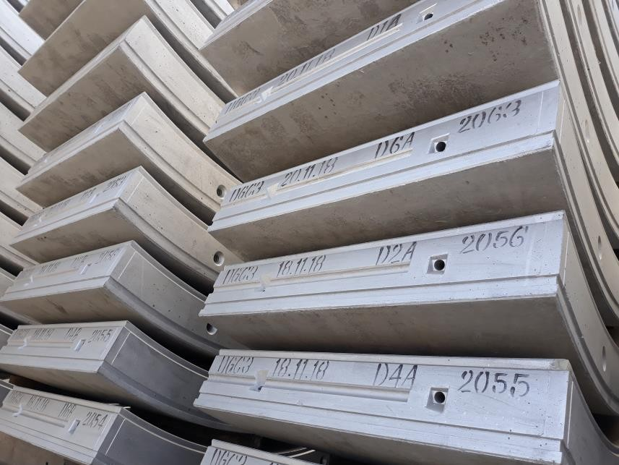
Features of Precast Concrete Mix
Mix design contain only OPC cement and supplemented with high fines reactive powder as strength enhancer.
Total binder content will be high compared to
traditional concrete for same grade.
Water cement ratio – generally in between 0.24 to 0.28
Designed for high early strength to increase productivity.
Less curing
Compressive strength requirements will be in the range of 10 to 12N/mm² in 10 hours
Normal curing procedure

Slide 4
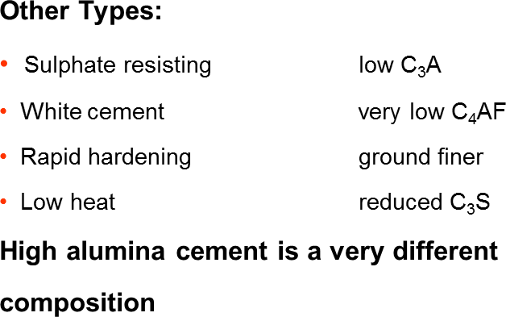
Role of Cement in Precast Concrete
Approximate composition of Hydrated cement products of OPC
% Composition
Symbol | Name | % present
C₃S | Tri-calcium silicate | 65%
C₂S | Di-calcium silicate | 20%
C₃A | Tri calcium aluminate | 8%
C₄AF | Tetra calcium alumino-ferrite | 5%
C3S C2S C3A C4AF

Slide 5



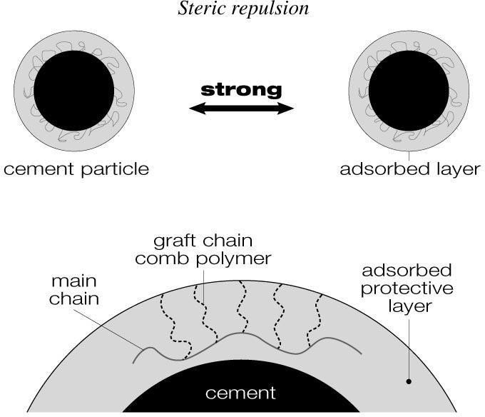
Dispersing Mechanism of PCE
Electrostatic repulsion
1st Generation Superplasticizer (SNF & SMF)
Steric repulsion
2nd Generation Superplasticizer (PCE)

Slide 6
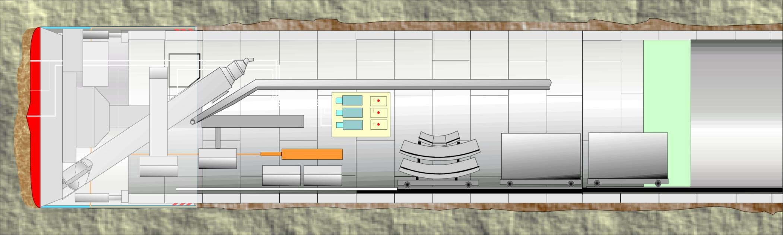
Below Ground - TBM
■
Precast segment
Auracast 270 M / PCE based
admixture
Tail sealant
Nitotunnel T2
Annulus grouting segment
Stabilizer - Conplast R
Bentonite – Conbextra AGB
Sodium Silicate – Sprayset SL/HBL
Soil conditioning
Foam : Nitotunnel TFA
Polymer : Cebex DSP1

Slide 7
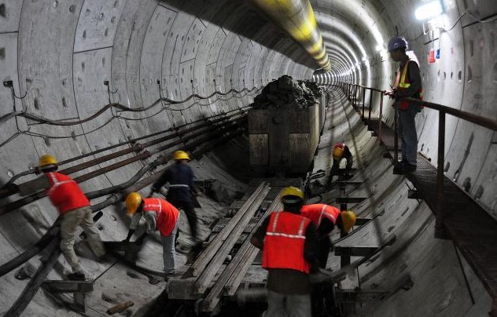
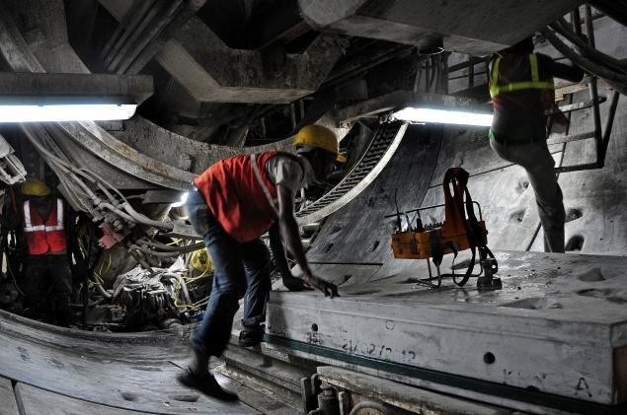
TBM- Admixture for precast segment
Typical performance requirement for
TBM Segment
  Typical Grade of concrete : M45 to M50
  Very low water cement ratio : As low as
0.26-0.29
  Workability retention : 45 min-90 min
  High early Strength : As early as 8-12 hrs in the range of 8 Mpa to 15 Mpa
  Durability tests
    RCPT : 600-1000 coulombs
    Water Penetration : less than 25mm
  Good surface finish with out any defects.
  Early strength using SCM

Slide 8
Fosroc – Solution for TBM segment
Auracast product series, a new generation, low viscosity, molecular designed PCE based Superplasticiser.
Auracast, designed for precast industry for high early strength and good surface finish.
Advantages of Auracast :
  Very low stickiness ,
  Very high water reduction, suitable for precast concrete
  Range of products to suit for normal workability vibrated through to self compacting concrete, and semi dry precast processes
  High early age strength - as early as 8 hrs
  Improved surface finishes with sharper arrises
  Single component, no need to add additional retarder or VMA
  Compatible with 100% crush Sand

Slide 9
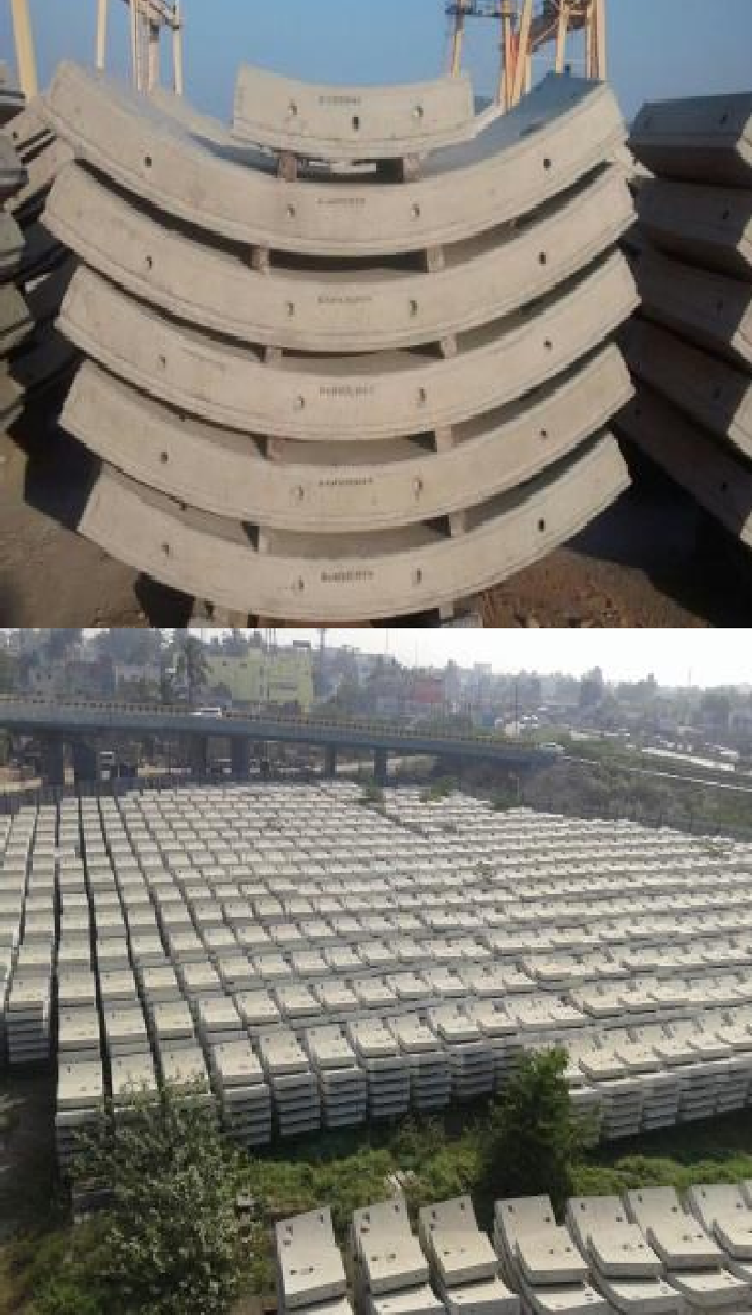
TBM Admixture Requirement
Project and performance requirements
Project Name
Contractor
(Below Ground)
Grade of Concrete Segment
Workability
Strength
RCPT
Water penetration
: Mumbai Metro Rail
: Soma Dogus
: 6 KM
: M50 for precast
: 120 mm after90 min
: 12 Mpa in 12 hrs
: 860 Coulombs
: 8.3mm

Slide 10
TBM Admixture Requirement
Results obtained using Admixture Fosroc Auracast 270 M at Soma
Workability Strength
Dogus :
Time in min | Slump in mm
0 | 170
45 | 150
120 | 125
Time | Strength in Mpa
12 hrs | 13.29
7 days | 58.29
28 days | 69.9
Slump in mm
Strength in Mpa
180
160
140
120
100
80
60
40
20
0
80
70
60
50
40
30
20
10
0
Slump in mm
Strength in Mpa
0
50
100
150
0
10
20
30

Slide 11
Wind Energy
Performance Challenges
Workability retention : Very high flow concrete with out any segregation
and bleeding:
Initial Flow
Flow after 45 min
Very high early strength
:700 -750 mm
: 600 -650 mm
- 20 Mpa at 9 hrs with hot air blower for 3 hrs
Concrete has to flow semicircular curved slender section with out any vibration-each segment requires 18 m³ concrete .One ring comprises of
4 such curved sections.
Excellent finish like mirror finish with out any surface defects.
Grade of concrete M40 – 450 kg (+25kg Alcofines+80Kg Fly ash)
Admixture : Aurcast 270M

Slide 12
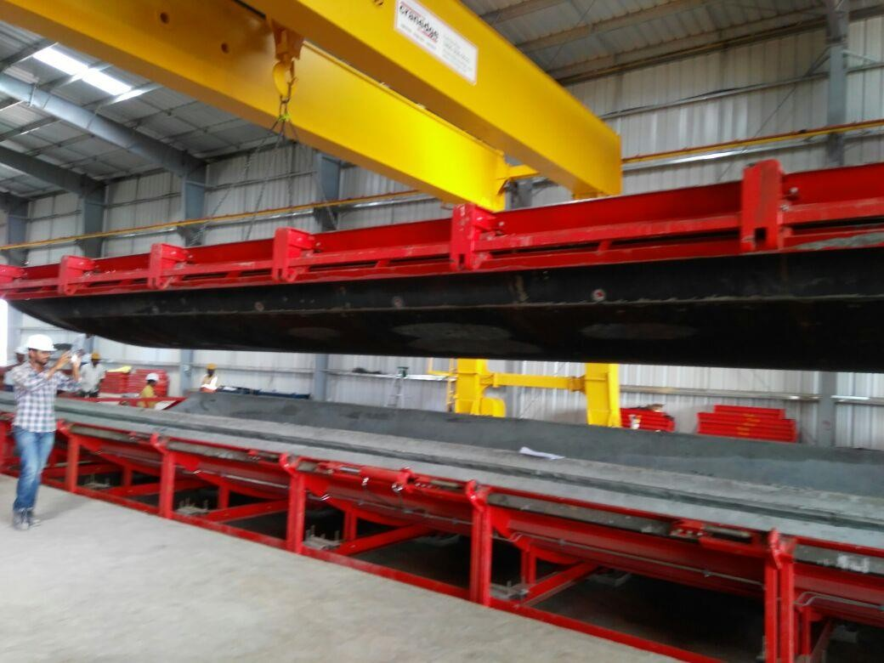
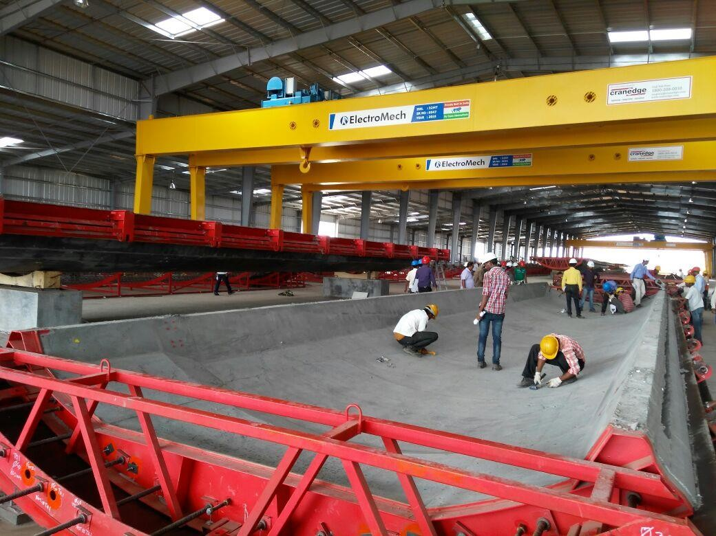
Wind Energy

Slide 13
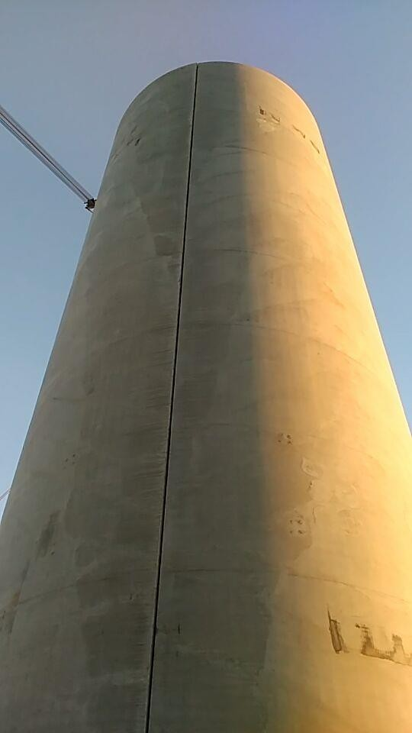
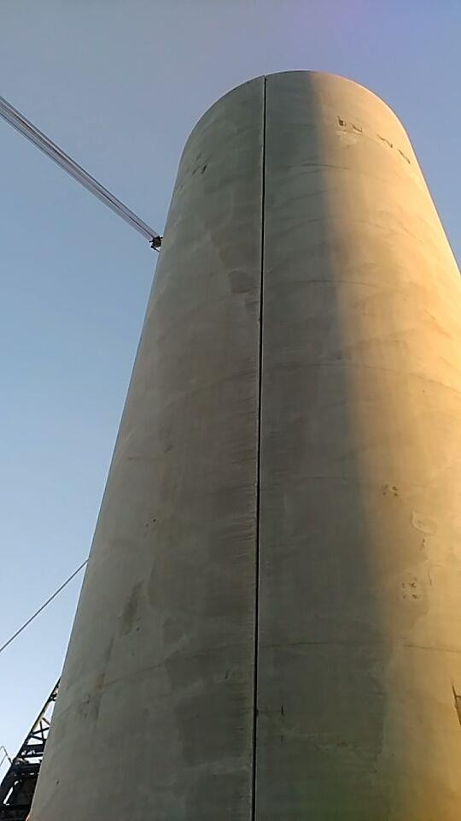
Wind Energy

Slide 14

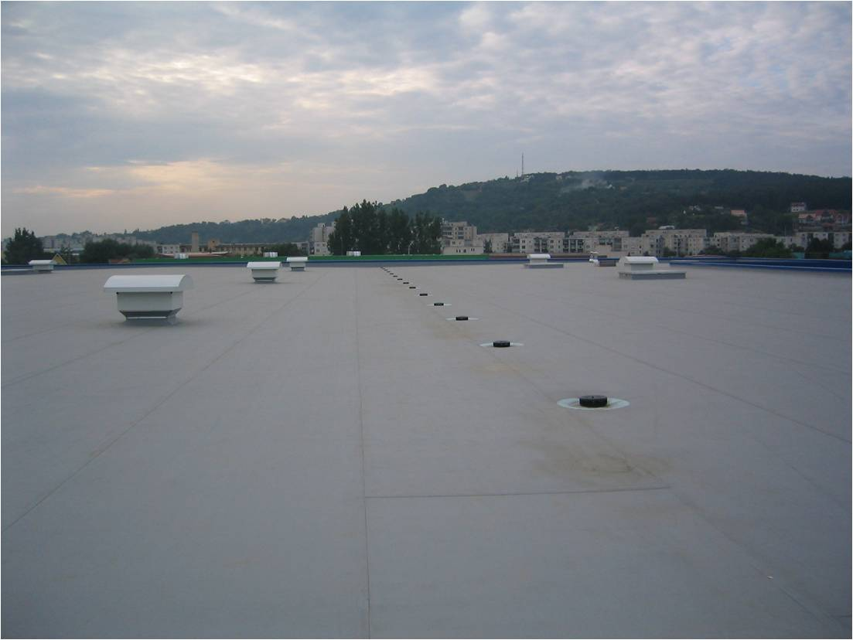
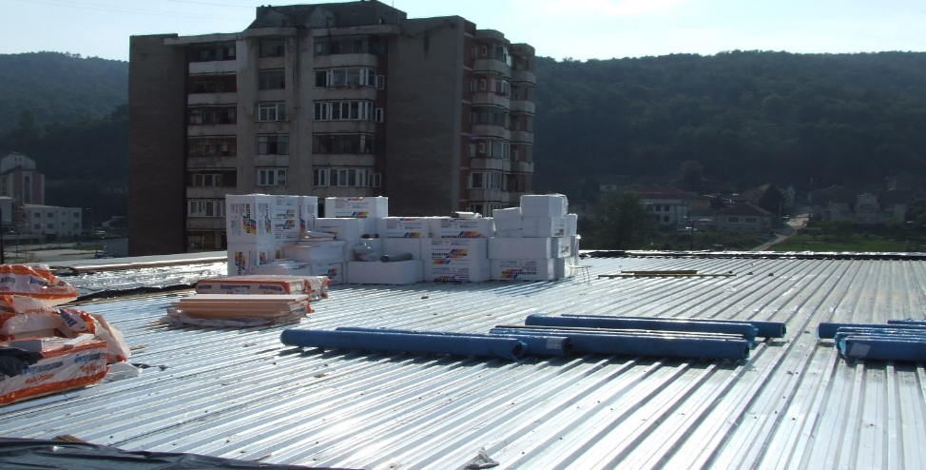
WATERPROOFING OF ROOF
Folded plate Roof
Concrete slab
Flat roof
Metal deck

Slide 15
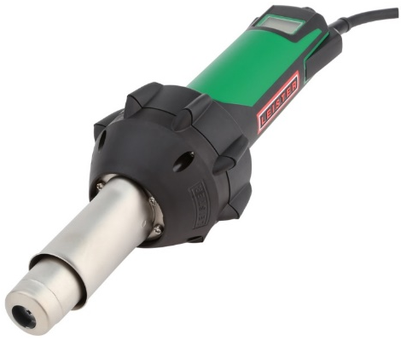
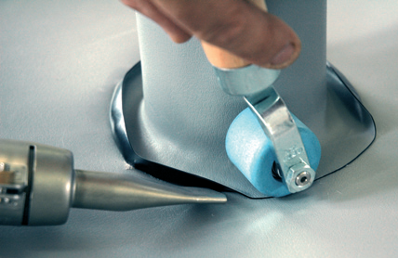
TPO based membranes
Fosroc TPO membrane systems are widely used for roof waterproofing applications especially on top of insulation
Outstanding elongation performance, >700%
Environment friendly
  Inert – no volatile components
  Hot air welded laps - no toxic fumes when welded
  No plasticisers that could leach out over time
No separation geotextile required at insulation interface
Compatible with bitumen for roof overlays.
Notes:
These advantages are against PVC systems

Slide 16
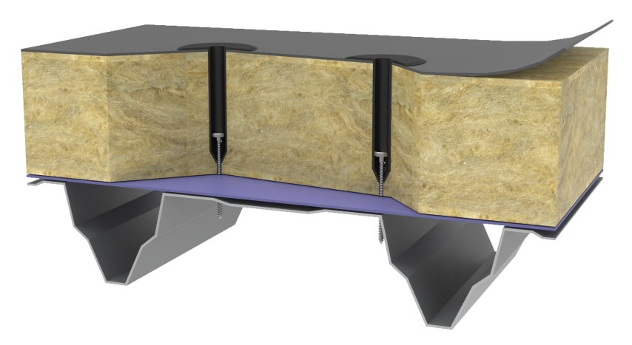
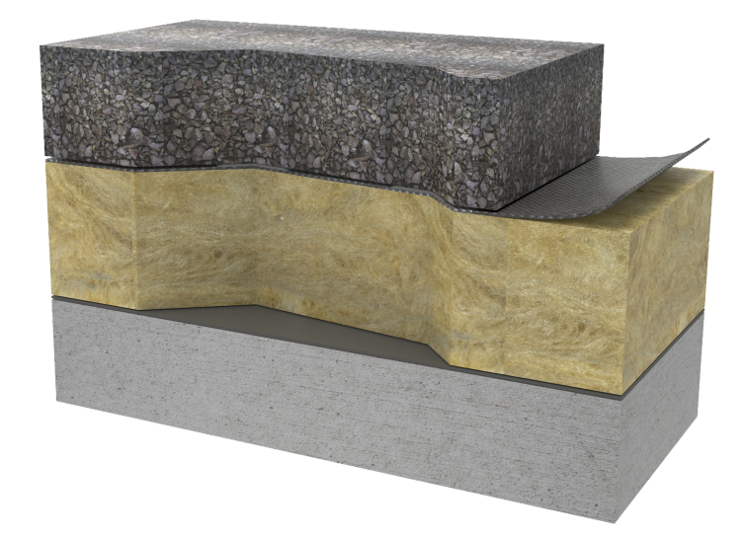
FIXING TYPES
Mechanically fixed system
  Vapour barrier
  Insulation mechanically fixed to deck
  Proofex OGP/ORG membrane mechanically
  fixed to deck
Adhered fully bonded system
  Proofex OFB membrane bonded to deck
  using adhesive
  Insulation glued to membrane
  Geotextile
  Ballast.

Slide 17
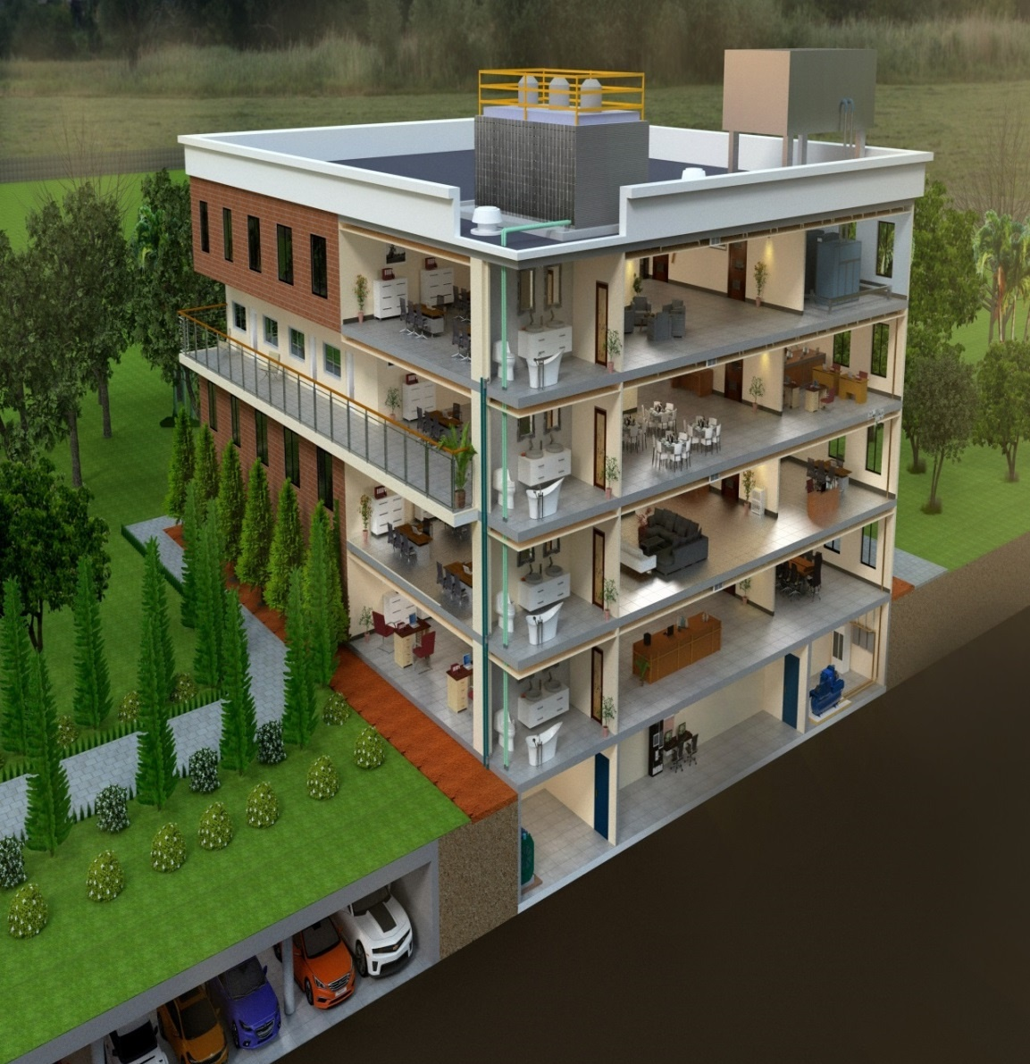
SPRAY APPLIED WATERPROOFING SYSTEM
Spray-applied, 100% solids, flexible, two-component, rapid curing Pure Polyurea Requirements Compatible for application on large area Resistance to strong roots Easy & quick to install Fully bonded system Accommodate thermal/structural movements Chemicals resistance Crack bridging Durable

Slide 18

FOSROC POLYUREA WPE
System Build-up
RCC Slab
Primer
2K Spray applied Polyurea System
UV Protective Coating
Geotext
Polymer Modified Screed

Slide 19
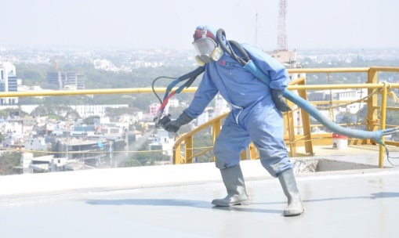
POLYUREA WPE
1
2
3
4
5
6
Fully Bonded & Seamless

Slide 20
POLYUREA WPE
1
2
3
4
5
6
Resistant to strong roots

Slide 21
POLYUREA WPE
1
2
3
4
5
6
Spray application

Slide 22
POLYUREA WPE
1
2
3
4
5
6
Green Product

Slide 23
POLYUREA WPE
1
2
3
4
5
6
Crack bridging

Slide 24
POLYUREA WPE
1
2
3
4
5
6
Certifications

Slide 25
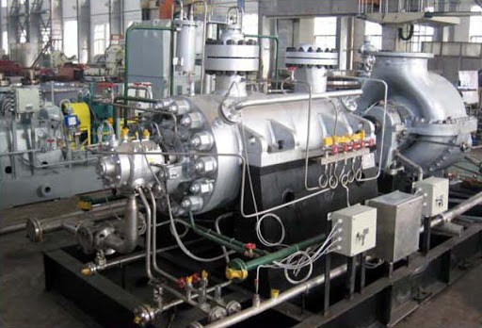
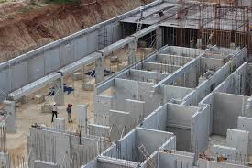
GROUT - CONBEXTRA GP2N
Free flow, High Strength, Non-Shrink,
Cementitious Precision Grout
Gaseous Expansion system compensates plastic shrinkage
Iron free and chloride free
Effective in transferring static loads and dynamic loads
Can be used for gap thickness upto 100mm
Application Areas
  Turbine base plates grouting
  Compressors base grouting
  Boiler feed pumps base plate grouting
  Precast segment joint grouting
Properties
  Unrestrained Expansion – 2 % to 4 %
  W/P ratio – 0.15(Pourable) & 0.16 (Flowable)
  Compressive Strength(N/mm²)
    1 day – 24 to 27
    7 day – 55 to 66
    28 day – 65 to 78
Packing & Yield
Packing | Water(L) | Yield (L)
25 kg | 3.75 | 13.0
25 kg | 4.0 | 13.2

Slide 26
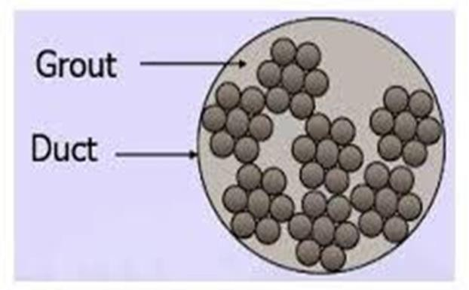
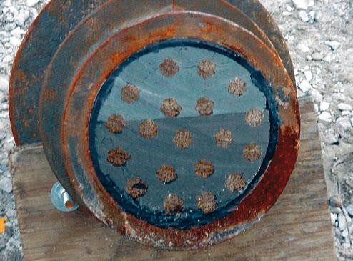
CABLE GROUT FOR POST TENSIONING SYSTEMS
Post tensioning is a technique for reinforcing concrete. Post-tensioning tendons, which are prestressing steel cables inside plastic ducts or sleeves, are positioned in the forms before the concrete is placed.
Once the concrete has gained the strength tendons are stretched by jacking and anchored to produce compressive forces in the member
The post-tensioning technique allows thinner concrete sections, longer spans between supports, stiffer walls to resist lateral loads and stiffer foundations to resist the effects of shrinking and swelling soils.
Post tensioning system is a primary structural component whose failure could result in total collapse of member

Slide 27
IMPORTANCE OF THE CABLE GROUT
The grout remains the primary protection to cables from moist & salt laden air .
Additionally grout provides transfer of pre-stressing forces to the structural member in a bonded post tensioning system .
Cementitious grout provides an alkaline environment that passivates the surface of steel and inhibits corrosion
The grout must surround and bond with steel to be effective

Slide 28
GROUT PRODUCTION – CURRENT PRACTICE
Site Batched grout - Constituents
    Cement - 50 Kgs
    Water(W/c ) - 0.39 – 0.42
    Non Shrink Additive - 225 gms
    Plasticizer / Water reducing
    Additive - 0.5 % by weight
    Bleed control Stabilizers - 0.005%
    Corrosion Inhibitors at times - As per design

Slide 29
CHALLENGES – ISSUES
High possibility of Human error in proportioning & Mixing
  Leads to batch variations
  Bleeding
  Loss of Positive expansion due to bleed
  Loss of strength
  & Ultimately corrosion of tendons

Slide 30
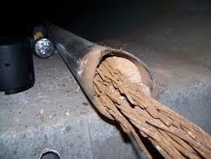
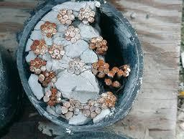
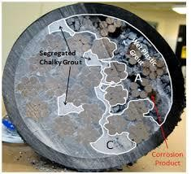
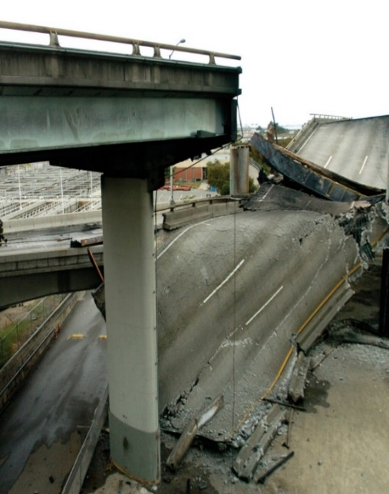
CONSEQUENCES
Poor protection to tendons
Corrosion Of tendons
Shrinkage and Creep
Loss of Pre-stress
Decrease in the Capacity of the design load
Decrease in durability and working life
& Ultimately Failure of the Structure

Slide 31
PRE PACKED GROUT
To eliminate the batch variations due to site proportioning
To follow strict specification of MORTH and EN447
To mitigate the errors of mixing, handling and application of the product
To save the time and increase the productivity of the construction
To avoid the frequent maintenance of the cable ducts
Can be formulated high strength grouts
& Ultimately cost saving and long term beneficial

Slide 32
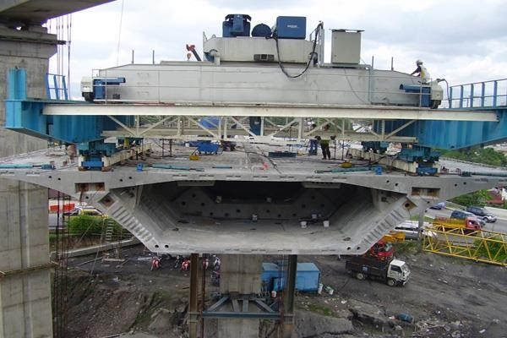
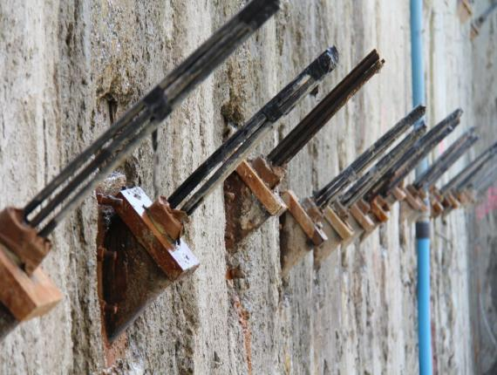
CONBEXTRA CABLE GROUT
Pre bagged, Non-shrink cementitious grout for post tensioned cable duct grouting
Gaseous Expansion system compensates shrinkage in plastic state
Iron free & chloride free
Pre packed, consistency in quality and performance
Flows EN447 and MORTH guideline for cable duct grouting
Application Areas
  PT cable duct grouting
  Grouting for ground anchors
Properties
  Unrestrained Expansion – upto 2 %
  W/P ratio – 0.33 to 0.35
  Bleed - < 0.3%
  Compressive Strength(N/mm²)
    7 day – >27
    28 day – >30
Packing & Yield
Packing | Water(L) | Yield (L)
25 kg | 8.25 – 8.75 | 16.5

Slide 33
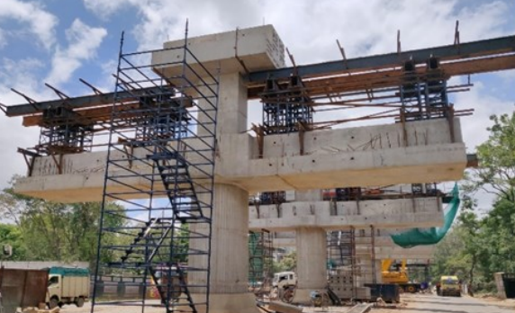
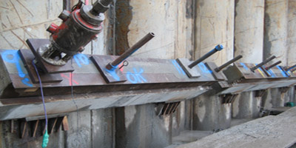
CONBEXTRA CABLE GROUT HS
Pre bagged, Non-shrink cementitious grout for post tensioned cable duct grouting
Gaseous Expansion system compensates shrinkage in plastic state
Iron free & chloride free
Pre packed, consistency in quality and performance
Flows EN447 and MORTH guideline for cable duct grouting
Application Areas
  PT cable duct grouting
  Grouting for ground anchors
Properties
  Unrestrained Expansion – upto 2 %
  W/P ratio – 0.28 to 0.3
  Bleed - < 0.3%
  Compressive Strength(N/mm²)
    7 day – >55
    28 day – >70
Packing & Yield
Packing | Water(L) | Yield (L)
25 kg | 8.25 – 8.75 | 15.5

Slide 34
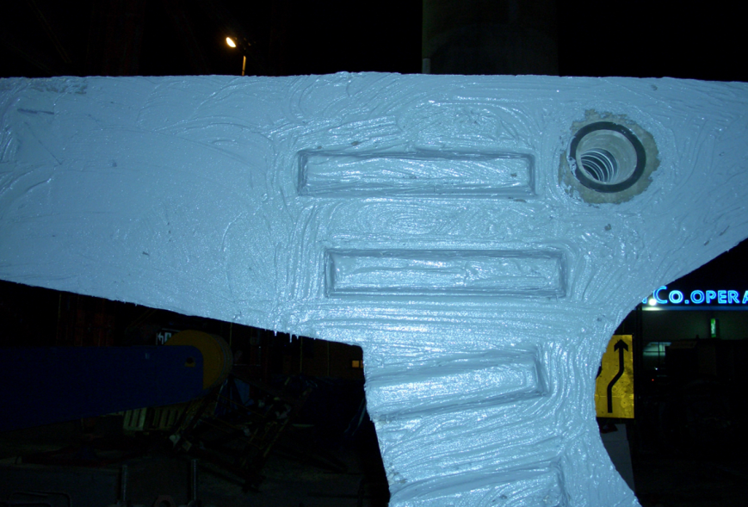
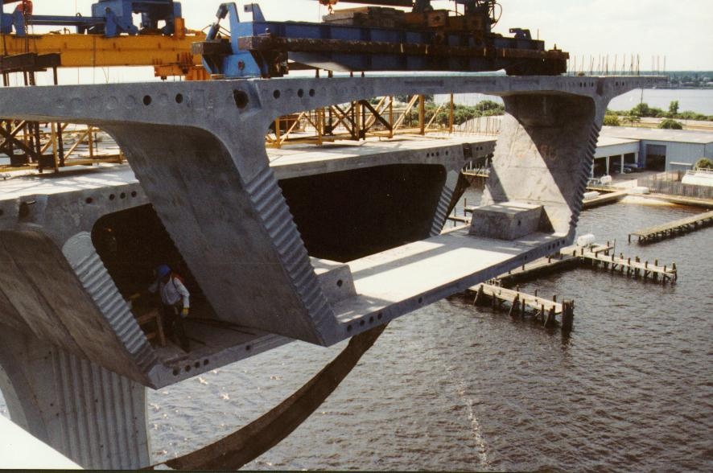
SEGMENT BONDING AGENT
Nitobond PC 20,30 & 40
  Grades available depending on ambient temperature application
    5 – 20⁰ C
    15 – 30 ⁰ C
    25 – 40⁰ C
  Complies to ASTM C881 Type VI
  Excellent adhesion to concrete
  Non-sag (2 – 3mm thickness)
  Long open time

Slide 35
SEGMENT BONDING AGENT
A thixotropic, two pack, solvent free epoxy resin system consisting of a white base & black hardener in pre weighed quantities.
Grade Setting Application Temperature
Nitobond PC 20 Fast 5-20 deg C
Nitobond PC 30 Medium Fast 15-30 deg C
Nitobond PC 40 Slow 25-40 deg C

Slide 36
SEGMENT BONDING AGENT
Function of Nitobond PC
For transfer of Compression, shear & some tensile stresses between segments.
Faster strength gain to allow continuous erection of segments.
Lubrication of joint faces during aligning.
To provide water resistant seal at joints.

Slide 37
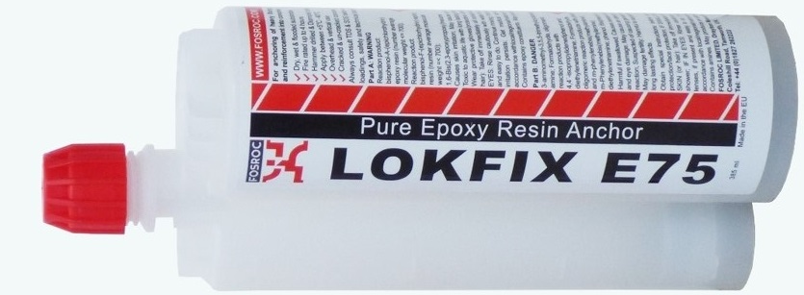
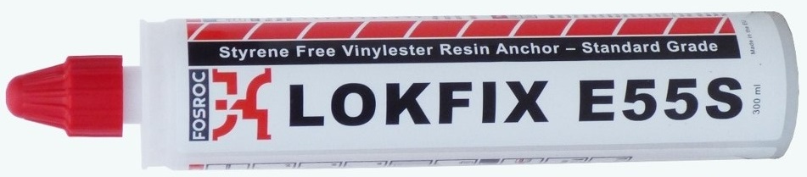
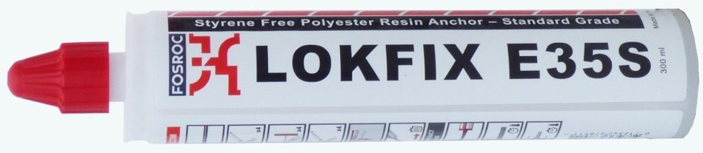
CHEMICAL ANCHORING
Pure Epoxy Chemical Anchor.
Vinyl Ester Styrene Free Chemical Anchor.
Polyester Styrene Free Chemical Anchor.

Slide 38






APPROVALS FOR LOKFIX E SERIES.
ETA
Fire Approval.
ETA Approval.
Seismic Approval.
LEED and VOC Approval.

Slide 39
PRODUCT POSITIONING
E55
Most versatile
Good accreditations
E35
Easy to use
Economic
E75
critical application
Best accreditations

Slide 40
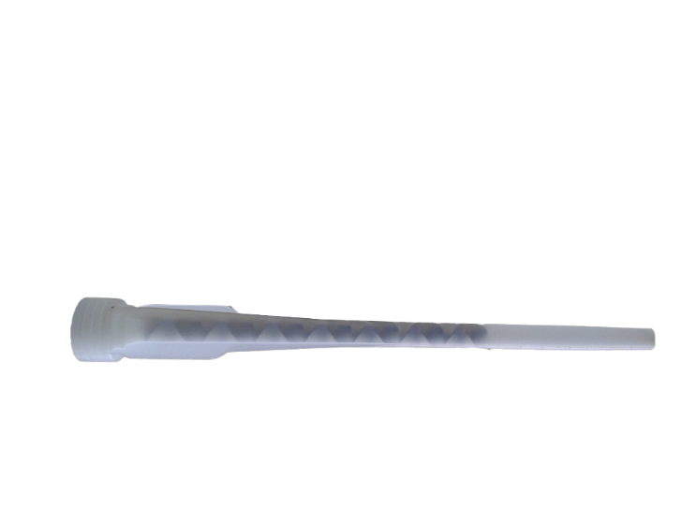
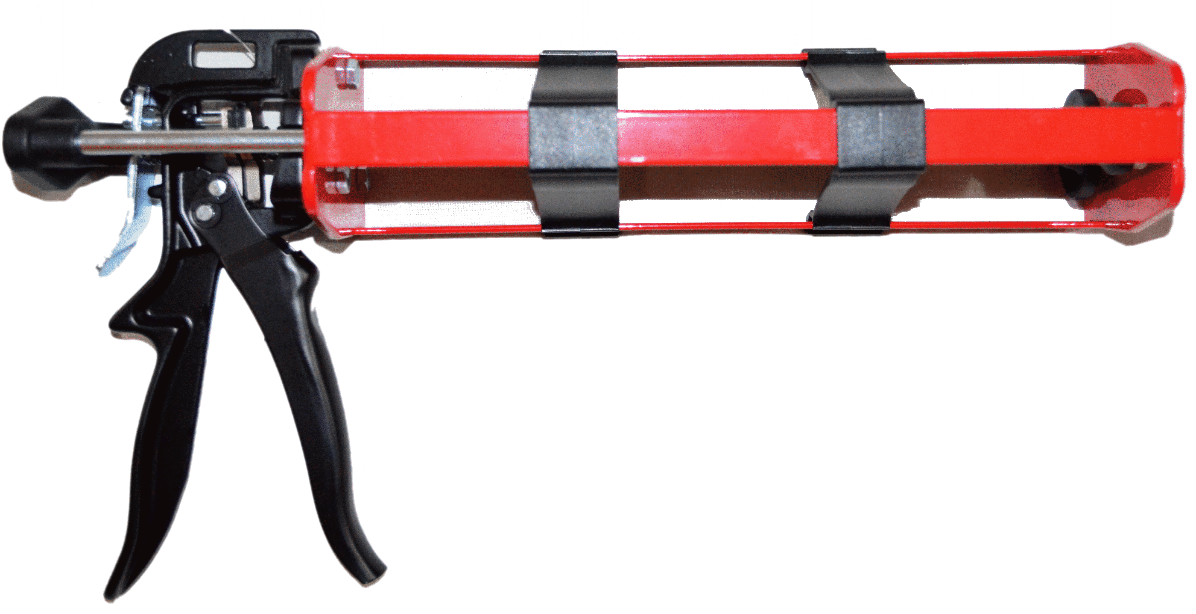
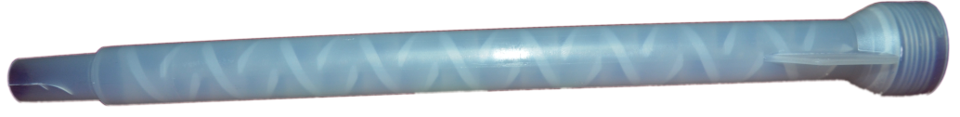
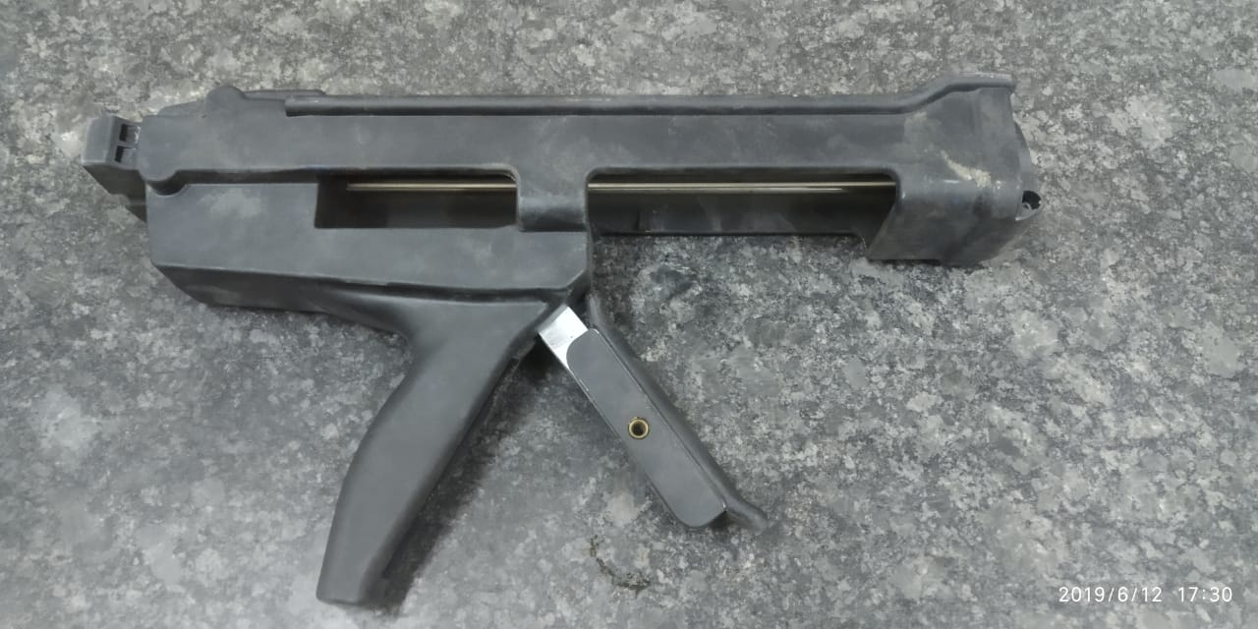

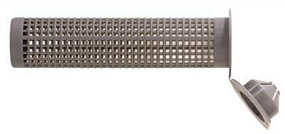
PRODUCT ACCESSORIES

Slide 41
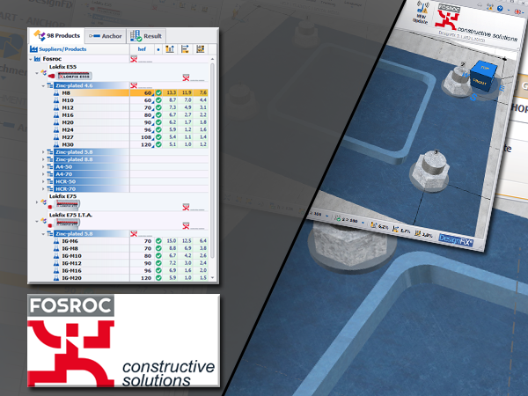
DESIGN SUPPORT.
LOKFIX E
Design Support
Fosroc have teamed up with DesignFix to create a bespoke software package to assist designers in the use of Lokfix E55 and Lokfix E75.
The system utilises the most-up-to-date design information and designs to the latest EAD accreditations. It is available in many different languages.

Slide 42
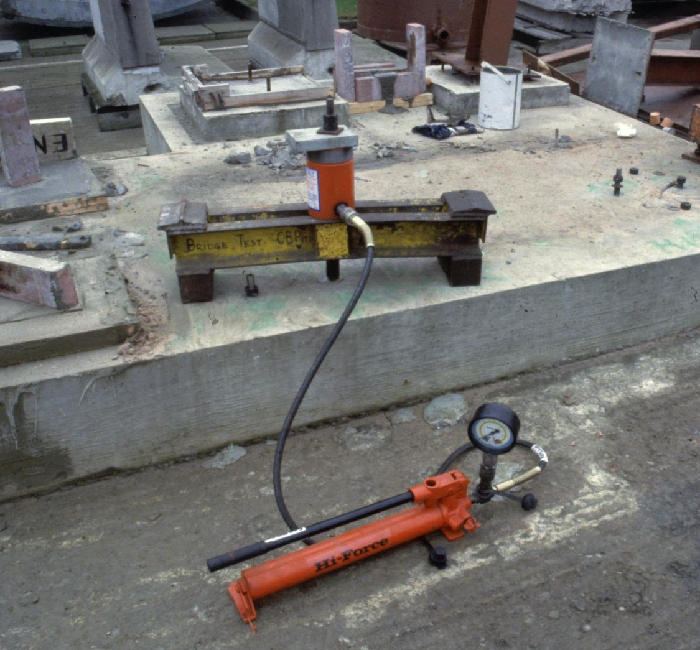
ON SITE TESTING
Pull out equipment
Notes:
Onsite Testing.
Fosroc India is equipped with the testing equipment for checking the performance of Reinforcement bars as well as threaded rods. The diameters from 8 mm to 40 mm of reinforcement bars and M8 to M30 diameters of threaded rods can be tested with 30 Ton and 60 Ton testers range.

Slide 43
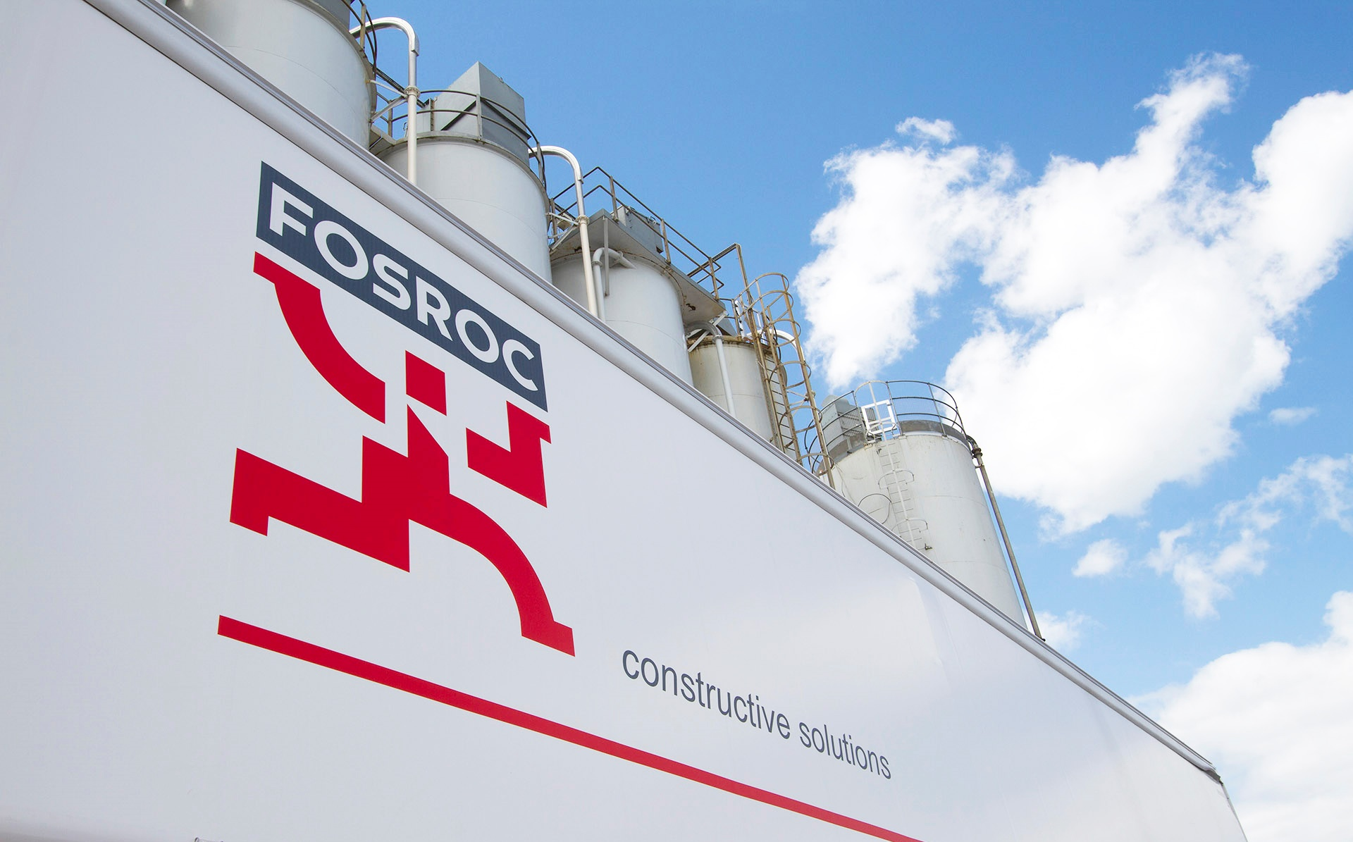



Thank You
Address
159 , Embassy Point ,Infantry Road,
Bengaluru,
Karnataka , India
Phone & Fax
Phone : +91 80 23551500/1/2/3
Fax :+91 80 23551510
Email: enquiries@fosroc.com
Social Media

